Slide 1
The Structure of Knowledge
Why your book may confuse you

Slide 2
Overview
How Humans Learn
Concretes, Concepts and Applications
The Problem
What This Has to Do with You
Exceptions
Takeaways

Slide 3

How Humans Learn
People's brains work in specific ways
There's a science to education
It's not just a ramble until the lecturer gets tired

Slide 4
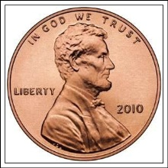
How Humans Learn To Count
Teaching children to count
Here is a penny. You now have 1.
Here's another penny. You now have 2.
3
4
5: Look at all those pennies!
Image source:
http://upload.wikimedia.org/wikipedia/commons/0/0c/2010_cent_obverse.png

Slide 5
Concretes
The number of pennies you have is a concrete: a physical, specific thing
Everything you interact with in the world is a concrete
You begin learning from concretes – there's nothing else to start from!
Image source:
http://upload.wikimedia.org/wikipedia/commons/0/0c/2010_cent_obverse.png

Slide 6
How Humans Advance
Working only with concretes gets you just so far
When you ask a toddler how old they are, they hold up their fingers and say, “this many”
Can you imagine contract negotiations happening this way?
“How much money do you want, Mr. President?”
“This many!”

Slide 7
Concepts
Concept: generalization of concretes that omits the non-essential
We refer to lots of these in our day-to-day life
Numbers
What does “5” or “30” mean?
A “desk” is a piece of furniture with a flat surface designed for working
Legs? Side panels? Drawers? Different for different desks, but don't change the underlying nature.
A “car” is a vehicle designed for people to get in and drive themselves around
Two door? Four door? 4WD? Cargo room? How many seats? What ties them all together is the concept car.

Slide 8
Concepts for Communication
Make civilization possible
Describe rules for categories of things
Example: If you have 10, and you add 5, you get 15.
Pennies? Bushels of wheat? Soldiers? Bits in a computer? YES.
Transmit knowledge
10+5 = 15 applies to all the examples above

Slide 9
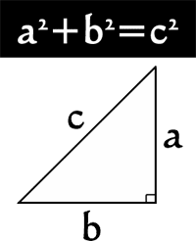
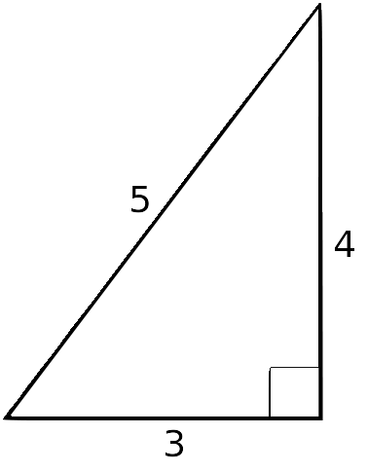
Concepts Applied
You may have learned about the Pythagorean theorem in Geometry.
For a right triangle...
In math class, they usually leave off the length of one side or the other and ask you to solve
We now have a concept. So what?
Images:
http://www.atlantic.k12.ia.us/~period5/Units/Triangles/Pythagoreantheoremandconverse.htm
https://upload.wikimedia.org/wikipedia/commons/6/67/3-4-5_triangle.svg

Slide 10
Concepts Applied
Construction workers have a problem: how to make sure angles are exactly 90 degrees?
Buildings need precise angles to be built right!
A half-degree off is a problem when you build a shed
A half-degree off is catastrophic when you build a skyscraper

Slide 11
Concepts Applied
Some smart woodworker building a fence saw the Pythagorean theorem and said, “I can use that!”
Measure four feet one way
Measure three feet the other way
Adjust the fence until you get a 5 foot diagonal
Perfect right angle!
Image source: https://upload.wikimedia.org/wikipedia/commons/6/67/3-4-5_triangle.svg

Slide 12
Concepts Applied
Finding new ways to apply existing concepts is a major way society moves forward
Trackballs existed in the 1940s, but when Douglas Englebart gave The Mother of All Demos in 1968, he turned the trackball upside-down and used it to move a cursor and select text
Google combined “online indexing” with “the number of links in to a page is a good indicator of quality” and suddenly had the best on-line search

Slide 13
The Problem
People who teach something are usually experts in that area, or they've run the class several times
They're no longer focused on the details or the initial up-take
They see neat patterns (concepts) that people who don't have their expertise miss
“It would be so easy if they just looked at it this way!”

Slide 14
The Problem
But it's not. You can't start with patterns and then go to concretes.
We don't teach kids to count by saying “There's a bunch of numbers, a whole lot of them, and they come one after the other, and they map to a specific number of things. The number 1 happens to map to this. The number 5 maps to this. Now, what's 3 + 4?”
...or don't we?

Slide 15

A Real-Life Example
In the late 1960s, California switched to “new math” in all its school programs.
Went straight for set theory and advanced math concepts, skipping that whole pesky concrete “this is 5 pennies” stage.
The result: an entire generation of kids who couldn't do basic math
Image source: http://www.amazon.com/Why-Johnny-Cant-Add-Failure/dp/0394719816

Slide 16
What This Has To Do With You
When you learn something new, you must start with concretes
So, when a book says something like:
The general syntax of a CSS style rule is selector { property1: value1; property2: value2; property3: value3; ... } before they actually show you an example, they're putting a hurdle in your way.
This literally has no meaning when you first encounter it. None!
It can be overcome by having an example immediately after the general form, and this book usually does that.
It would still be better to do it the other way around.

Slide 17
What This Has To Do With You
Have you ever read an instruction manual, had to figure it out on your own, and then the manual only made sense after you understood it?
It's possible the book's giving you concepts when you need concretes
The solution: go find some concretes (example code, sample problems...) and work with them until you see the pattern.

Slide 18
Exceptions
There are rare people whose minds do, in fact, work the other way around
“Global learners”
Start with the big picture, then fill in details
Not generally good at explaining how they do things
Will come up with novel/unusual approaches
This is part of the reason good textbooks give the big-picture intro for a moment before diving into details

Slide 19

Takeaways
Pay attention to how knowledge is communicated
Getting confused? Concretes, then concepts
If the book does it wrong, you have to find/make/practice with concretes until the general principle makes sense
More information:
Philosophy of Education, by Leonard Peikoff
Why Johnny Can't Add, by Morris Cline
Learning styles: http://www4.ncsu.edu/unity/lockers/users/f/felder/public/ILSdir/styles.htm

